Slide 1
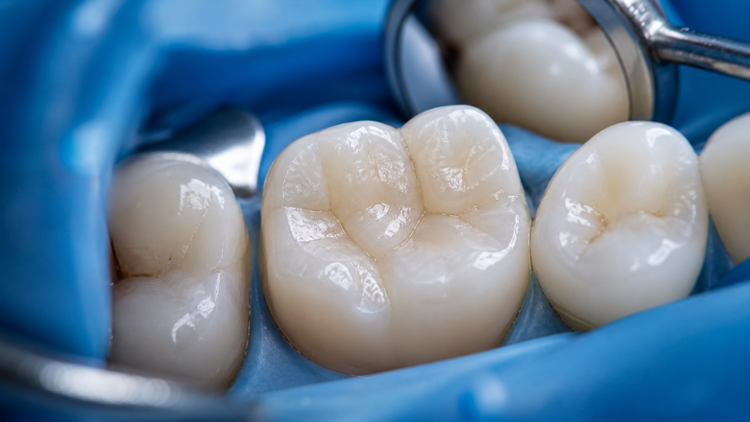
2-DAY INTENSIVE PROGRAM
Modern Posterior
Composite Restorations
Function • Anatomy • Speed • Complex Molar Cases
A hands-on clinical training focused on predictable, efficient and natural direct posterior composite restorations.

Slide 2
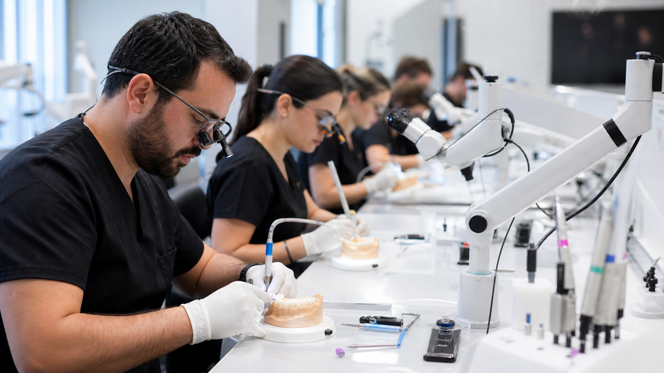
Program Overview
A clear learning path from morphology fundamentals to complex posterior rehabilitation.
This program is fully dedicated to modern posterior composite restorations, with a strong focus on molars.
01
Functional occlusal anatomy
02
Fast posterior modelling
03
Class I & Class II restorations
04
Cusp coverage, deep margins & isolation
Evidence-based theory + extensive hands-on practice

Slide 3
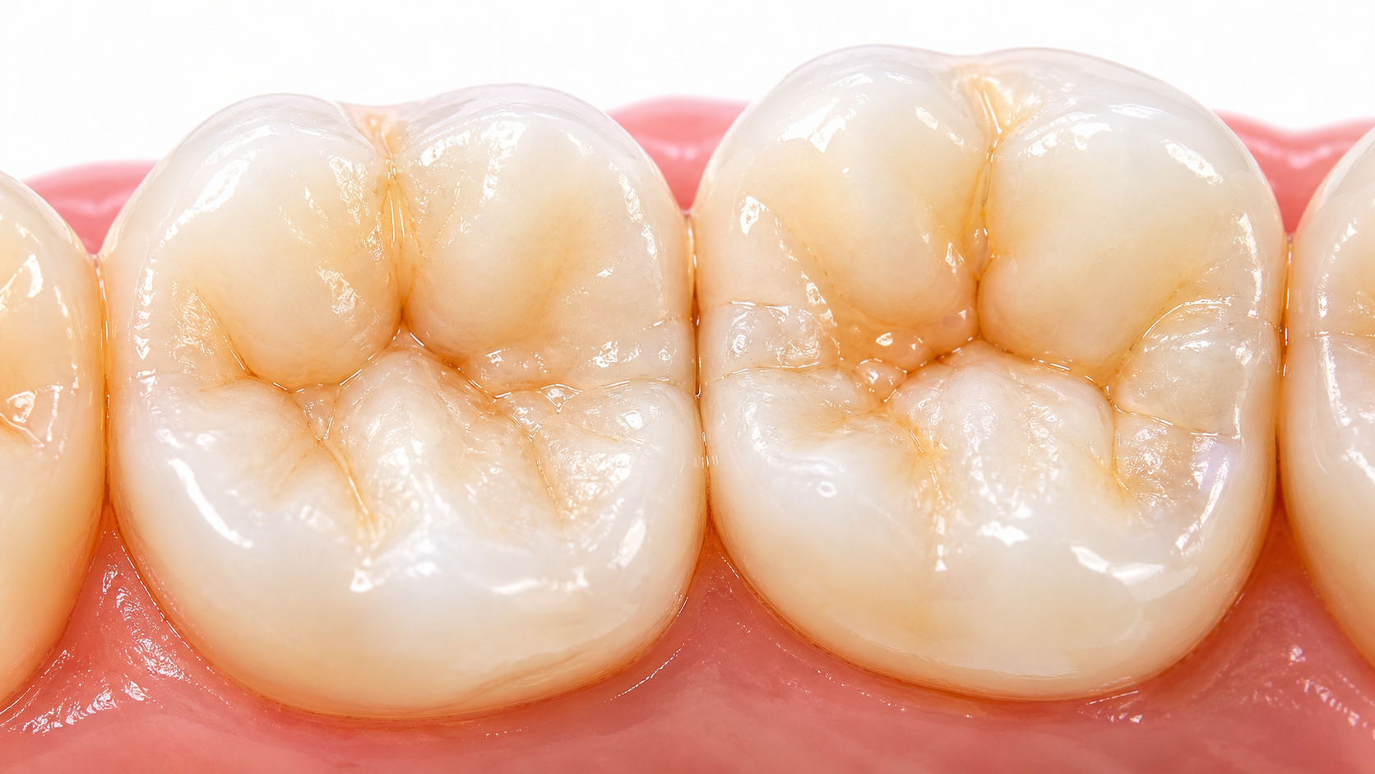
What Participants Will Gain
Practical skills designed to transfer immediately into daily clinical practice.
1
Simplified posterior anatomy without over-detailing
2
Faster, more predictable modelling workflow
3
Confidence with complex molar restorations
4
Modern protocols for long-term success
5
Clinical decision-making for direct vs indirect
The central principle: maintain natural morphology and function while simplifying the clinical workflow.

Slide 4
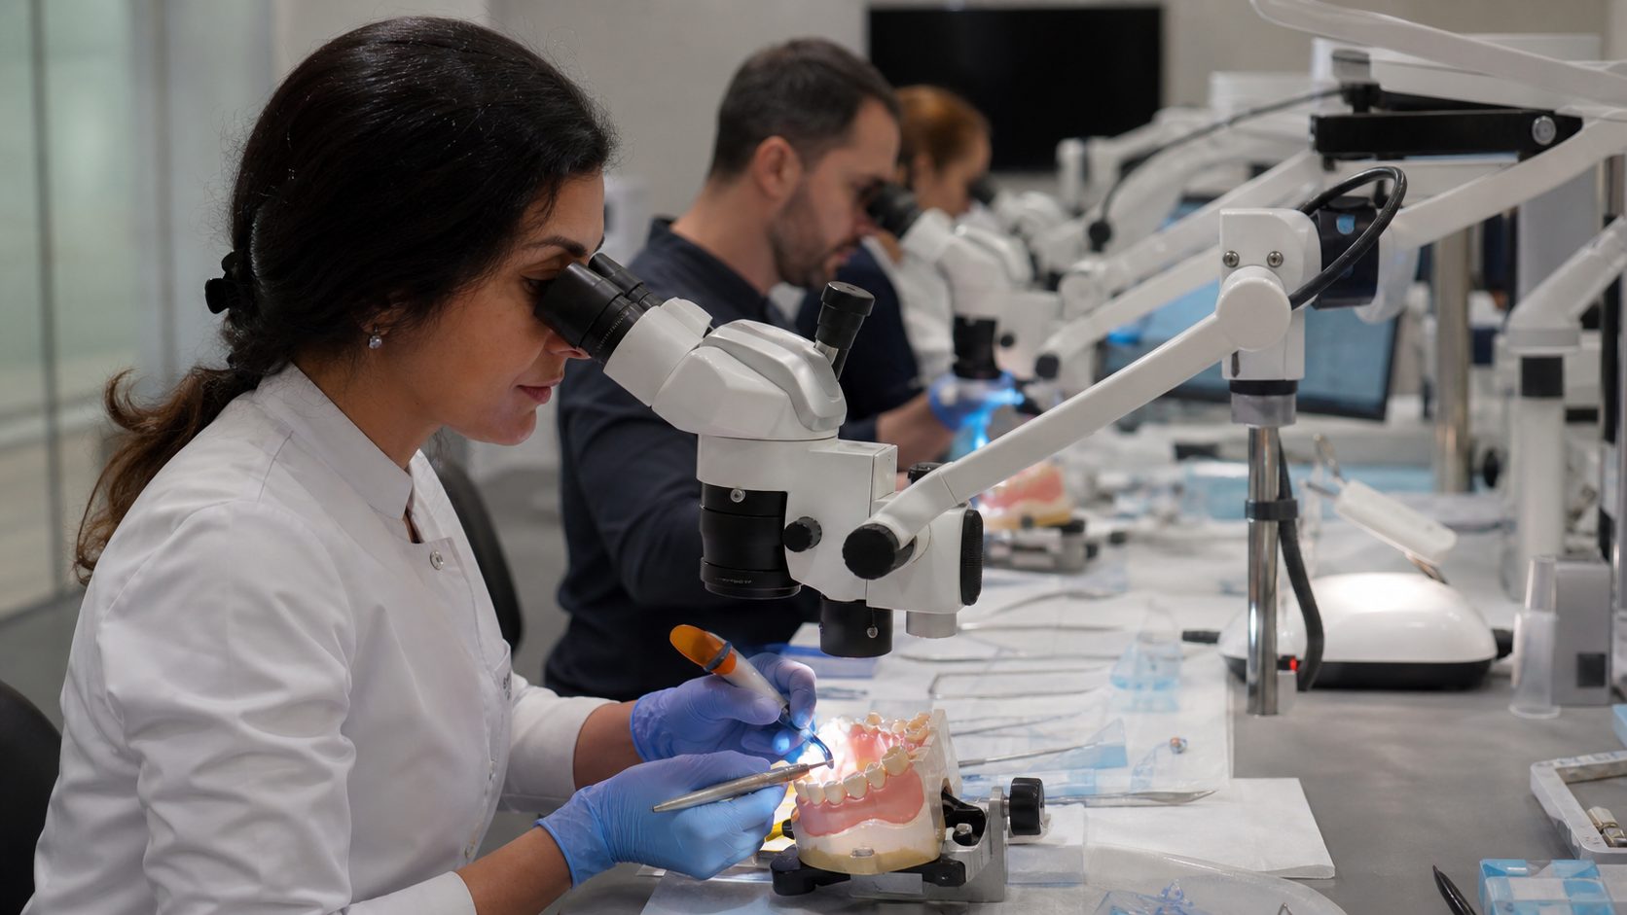
Day 1 — Function, Anatomy & Speed
From morphology principles to fast Class I modelling.
1
09:00–10:30
Lecture Block 1
Functional occlusal anatomy & posterior morphology
2
10:45–12:30
Lecture Block 2
Fast posterior modelling & daily workflow
3
13:30–15:30
Hands-On 1
Class I restorations: molars & premolars
4
15:45–18:30
Hands-On 2
Advanced anatomy & surface detailing
5
18:30–19:00
Q&A
Troubleshooting, case discussion & optimization
Coffee: 10:30 & 15:30 • Lunch: 12:30

Slide 5
Day 1 Learning Focus
The first day builds anatomy literacy and speed without sacrificing quality.
Anatomy that matters
Core principles, proportions, landmarks and structure over unnecessary fissure detailing.
Fast modelling workflow
Step-by-step Class I approach, flowable composites and reducing occlusal adjustments.
Surface finishing
Natural texture, staining, translucency control and efficient polishing strategies.

Slide 6
Hands-On Practice
Clinicians practice on 3D printed models using modern posterior protocols.
Upper jaw models
Lower jaw models
Detailing tools
Class I molars & premolars
Class II restorations & cusp build-up
Fissure stains, flowable composites & polishing systems

Slide 7
Day 2 — Complex Cases & Advanced Techniques
The second day moves into large defects, deep margins, cusp coverage and Class II execution.
1
09:00–10:30
Lecture Block 3
Cusp coverage & severely damaged teeth
2
10:45–12:30
Lecture Block 4
Construct concept & realistic posterior anatomy
3
13:30–15:00
Lecture Block 5
Deep margin elevation & complex isolation
4
15:15–18:30
Hands-On 3
Class II restoration & cusp build-up
5
18:30–19:00
Wrap-Up
Case analysis, protocols & common mistakes
Coffee: 10:30 & 15:00 • Lunch: 12:30

Slide 8
Advanced Clinical Protocols
A structured approach for molars with large defects and difficult margins.
1
Direct vs Indirect
2
Cusp Build-Up
Decision-making for large posterior defects
Step-by-step reinforcement and functional anatomy
3
Deep Margin Elevation
4
Complex Isolation
Managing subgingival and difficult margins
Techniques for challenging access and missing adjacent teeth
Focus: predictable function, cleanability, biology and long-term outcomes.

Slide 9
Hands-On Materials & Equipment
Materials selected to support fast modelling, depth, texture and polish.
Restorative Materials
SDR+ • Spectra ST composites • Flowable composites
Characterization
Fissure stains • White tints • Depth effects
Finishing & Polishing
Polishing systems • Micromotors • Time-efficient protocols
Optional Systems
Air abrasion systems using glycine
Designed for real daily practice — not only demo dentistry

Slide 10
FINAL TAKEAWAY
Simplify anatomy.
Increase speed.
Restore function.
A complete posterior composite workflow from everyday Class I cases to complex molar reconstruction.
Ready-to-use clinical protocols for predictable direct composite restorations.

