Slide 1
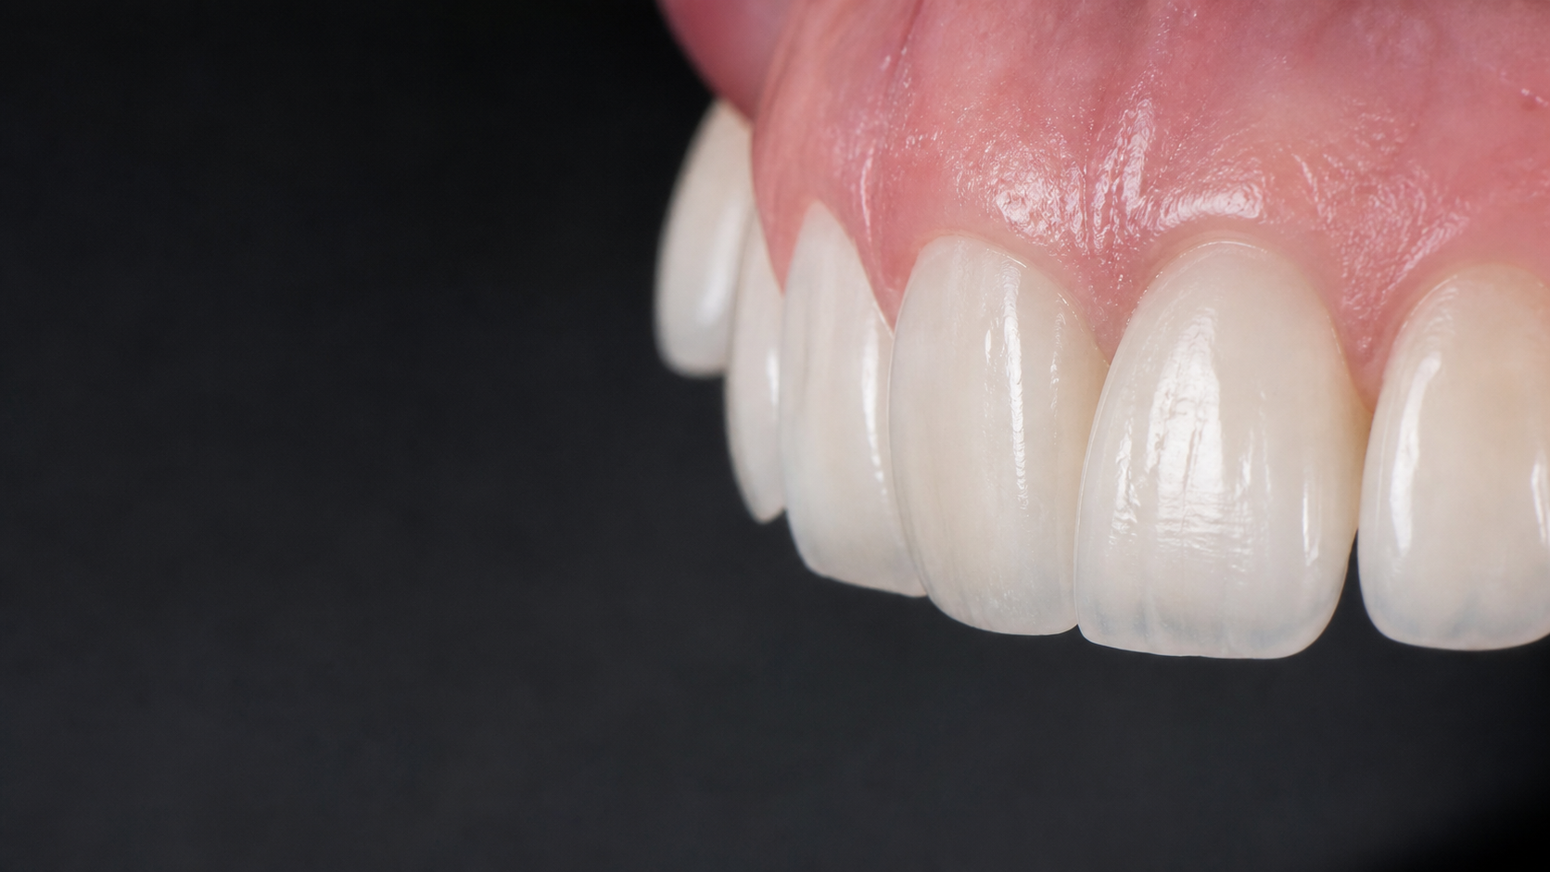
OCTOBER 23–25
Anterior Composite
Restorations
Optics • Layering • Morphology • Finishing
LIU JINGJIN PRESENTATION

Slide 2
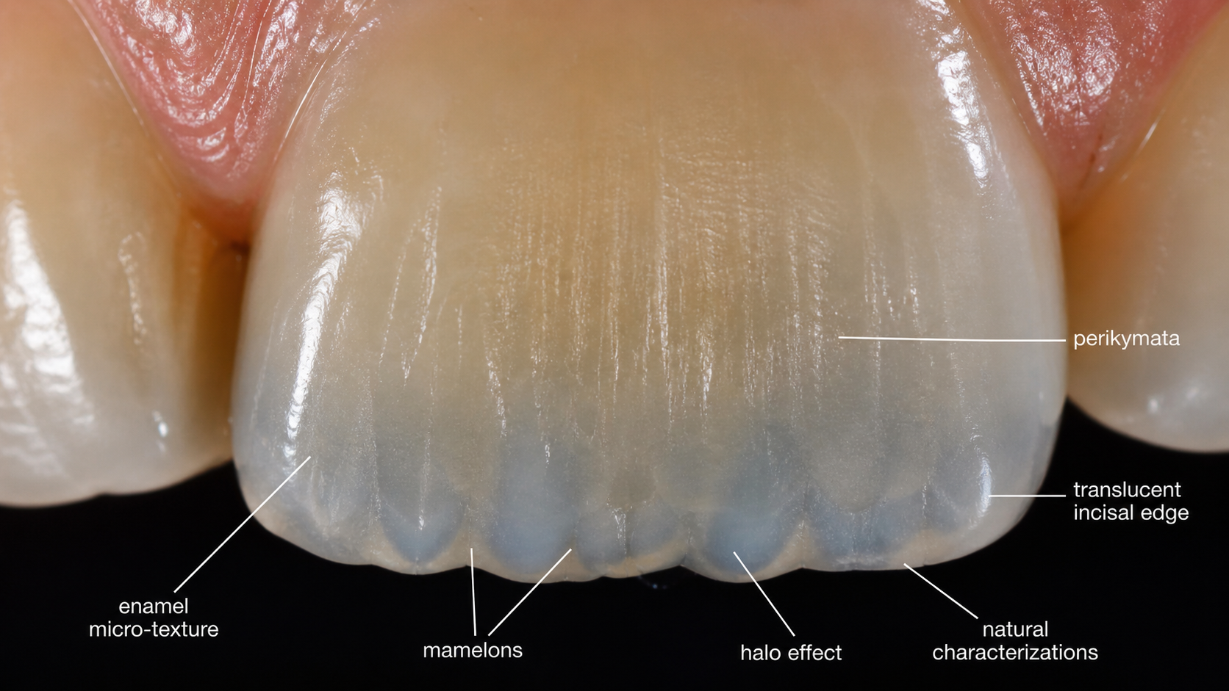
Course Focus
Modern protocols for natural anterior composite restorations
Create and transfer color with a simplified anterior construction concept
Understand optics of dental tissues and composite materials
Design translucency, internal structures, mamelons and halo effects
Connect theory, microscope demonstration and hands-on practice
PROGRAM FLOW
Theory → Live microscope demonstration → Hands-on anterior modelling → Finishing and surface micro-texture
Liu Jingjin Presentation • 2

Slide 3
Day 1 — April 12
Morning theory: color, optics and chromatic design
10:00–12:00 | FIRST THEORETICAL BLOCK
Concept of anterior tooth construction — the simplest way to create and transfer color
Optics of dental tissues and composite materials
Anatomy of translucency
Internal structures of anterior teeth: optical and photochemical characteristics
Structural details and their variations
Composite shade selection protocol
12:00–12:30 | COFFEE BREAK
12:30–14:00 | SECOND THEORETICAL BLOCK
Optical features of anterior teeth
Composite tints, chromatic design, dentin body and mamelon reproduction
Layer configuration for translucency levels and halo effect reproduction
Liu Jingjin Presentation • 3

Slide 4
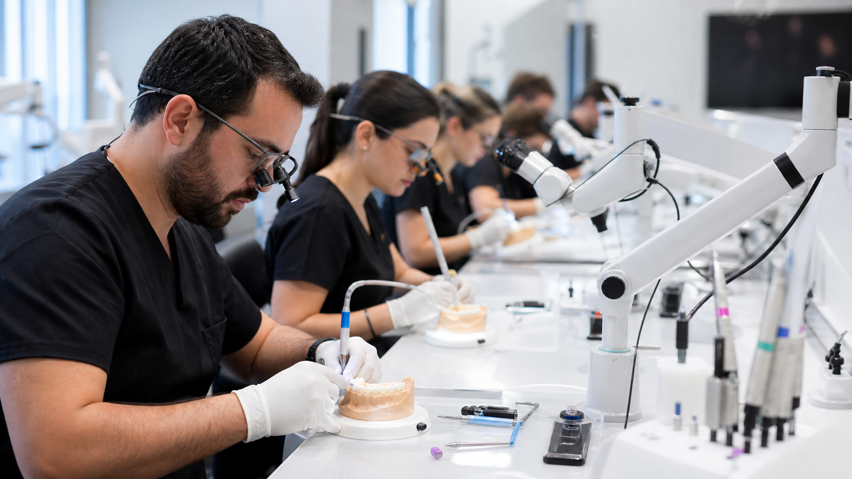
Day 1 — Afternoon & Evening
Finishing protocols, live demonstration and clinical Q&A
14:00–15:00
Lunch Break
15:00–17:00
Third Theoretical Block
Finishing protocols; grinding, polishing and micro-texturing; anterior morphology and texture; surface structure, proportions, incisal edge morphology and perikymata; efficient finishing principles.
17:00–19:30
Live Demonstration
Clinical demonstration by the lecturer under magnification with microscope work.
19:30–20:00
Dinner
20:00–22:00
Q&A Session
Clinical case discussions, extended analysis and troubleshooting.
Liu Jingjin Presentation • 4

Slide 5
Day 2 April 13
Participant’s choice: one complete hands-on day
10:00–11:00
Introductory Lecture
11:00–12:30
Hands-On Session 1
Restoration build-up using the author’s concept; step-by-step anterior modelling; logic of composite layering; working with anatomical structures.
12:30–13:00
Coffee Break
13:00–15:00
Hands-On Session 2
Color and shade management; composite material selection and combination; tinting techniques; chromatic effects, mamelon and depth simulation; halo effect creation.
15:00–16:00
Lunch Break
Liu Jingjin Presentation • 5

Slide 6
Hands-On Day — Final Sessions
Morphology, certificates and final practical finishing
16:00–19:00
Hands-On Session 3
Creation of natural morphology; development of anatomical form; control of translucency and volume.
19:00–19:30
Certificate Ceremony
19:30–20:00
Dinner
20:00–22:00
Final Practical Session
Finishing procedures; grinding and polishing; surface micro-texturing; perikymata formation; detailed instrument and technique overview.
Liu Jingjin Presentation • 6

Slide 7
Optical Anatomy & Characterization
The esthetic result depends on how light, color and texture are controlled
Translucency is designed through layered opacity, volume and material selection
Mamelons and dentin body create internal depth
Tints reproduce subtle chromatic effects without over-darkening
Halo effect and incisal edge design create natural realism
Perikymata and micro-texture complete the final visual integration
Liu Jingjin Presentation • 7

Slide 8
Hands-On Skill Map
A repeatable clinical sequence for anterior composite restorations
1. Build-up
2. Layering logic
Author’s concept, anatomical form and anterior tooth modelling.
Composite layers configured for translucency, body and volume control.
3. Color effects
4. Surface finish
Shade management, tinting, mamelons, chromatic depth and halo effect.
Grinding, polishing, micro-texturing and perikymata formation.
Goal: simplify complex anterior esthetics into a clear, teachable and clinically usable workflow.
Liu Jingjin Presentation • 8

Slide 9
What Participants Will Gain
Practical protocols ready for daily practice
Clear understanding of anterior optical anatomy
Reliable shade selection and color transfer strategy
Confidence with tints, mamelons, halo effects and translucency control
Hands-on experience in anterior tooth modelling and layering
Finishing and polishing strategies for texture, shine and natural morphology
Liu Jingjin Presentation • 9

Slide 10
Liu Jingjin Presentation
Anterior Composite
Restorations
Theory • Microscope Demonstration • Hands-On Practice
October 23–25

